Slide 1

Store Data Analysis
Team Members:
Elena Magdy Kamel
Rawan Mohamed Khairy
Mohamed Fayez
Talat Mohamed
Zyad Elrefai

Slide 2
Store Data Analysis
Team Members:
Elena Magdy Kamel
Rawan Mohamed Khairy
Mohamed Fayez
Talat Mohamed
Zyad Elrefai

Slide 3


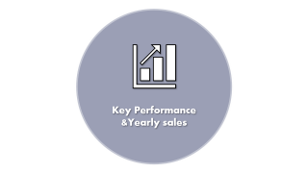






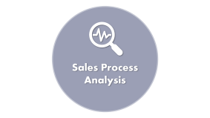




Store Data Analysis
Team Members:
Elena Magdy Kamel
Rawan Mohamed Khairy
Mohamed Fayez
Talat Mohamed
Zyad Elrefai
Store
Analysis

Slide 4

Project Goals

Slide 5


Project Goals
The aim of the project is to identify the problems that affect the sales ratio in the United States of America through the following:
Sales ratio in each state over the years from 2015 to 2018. Providing a model to make predictions of sales ratios in the coming year. Identifying the strengths and weaknesses that affect sales.
Knowing customer performance and the extent of the impact of customer satisfaction on sales ratio.
Knowing product performance and identifying the best-selling and least-selling products.
Determining the performance of logistics services to know the shipping performance in each state.

Slide 6

Sales Process Analysis

Slide 7



Sales Process Analysis
Clean data And Preprocessing, identify sales ratios and display them to understand the problem.(Using Python)
Determine analysis questions That Help Making Decision
Determine a set of forecasting questions and Make Model to Predict Sales Ratio
Build a Tableau visualization dashboard that visualizes the answers to all answered questions
Central and Supporting insight
Solution And Recommendation

Slide 8

Cleaning Data and Preprocessing

Slide 9


Process Summary
Data loading and inspection
Loaded the dataset, checking for missing values and data types.
Zero filled for missing postal codes.
Exploring Categorical Data
Analysed key categories: Ship Mode, Segment, and Product Category.
Converting Dates
Converted the Order Date and Ship Date into datetime format for analysis on shipping.
Outlier detection and removal
Applied Box Plot and IQR method for outlier removal in Sales column.
Cleaning Data
Removed duplicate records and altered data types to standardize.
Cleaning Data and Preprocessing

Slide 10

Key Insight

Slide 11



A datetime conversion opens the avenues to delays in shipping and inefficiency.
Removing outliers ensures that extreme values don’t skew the analysis.
Product and Category Analysis Potential Categories and sub-categories need further exploration to identify the most and least profitable products.
Key Insight

Slide 12

Analysis Questions

Slide 13

Through this stage, we determine the goal of asking questions that help us make a decision and determine questions for each goal and know the insights from them.
Goals :
Know the extent of customer satisfaction BY Shipping Analysis , Customer Performance
Determine key performance metrics and Yearly sales Overview
Know the strengths and weaknesses By Product Performance , Geographical Performance .
Analysis Questions

Slide 14

Customer Satisfaction

Slide 15

Customer Performance :
Which customer segment has the most orders?
What is the number of products for each customer per order?
Which customer placed the most orders?
What is the total sales generated by each customer?
Which customers purchased the most products overall?
Shipping Analysis
What is the average shipping time (days between order date and ship date)?
What is the most popular shipping mode?
Customer Satisfaction

Slide 16

Key Performance &Yearly sales

Slide 17
Key Performance &Yearly sales
What is the total number of orders in the dataset?
What is the total revenue (sum of sales) across all orders?
How many unique customers are there?
What is the total sales by year?
How many orders and what is total sales were placed in each quarter of the years?
How many orders were placed each month?
Geographical Performance
What are the top 5 states by sales?
What are the top 10 cities by sales?
which city has the highest number of orders?
What is the total revenue by region?
Which state has the highest number of customers? What is the total number of orders for each region?

Slide 18

Strengths and Weaknesses By Product

Slide 19

Strengths and Weaknesses By Product
Which product category generates the most sales?
What are the top 10 products by revenue?
Which product category has the highest average sales price?
Which product sub-category has the highest sales volume?

Slide 20

Visualization Dashboard

Slide 21
At this stage, the previous questions are answered and displayed in the Dashboard, focusing on the most important points to identify the problems that cause a decrease or increase in sales, in addition to providing solutions and recommendations to help decision makers.
For Example:
Customer Performance
Product Performance
Shipping Performance
Geographic Performance
Visualization Dashboard

Slide 22

Forecasting Questions

Slide 23
Forecasting Questions
What are the expected sales for the next quarter?
What are the top-selling products expected to be in the next month?
What will be the peak demand period for a specific product?

Slide 24

Sammary
Dashboard

Slide 25
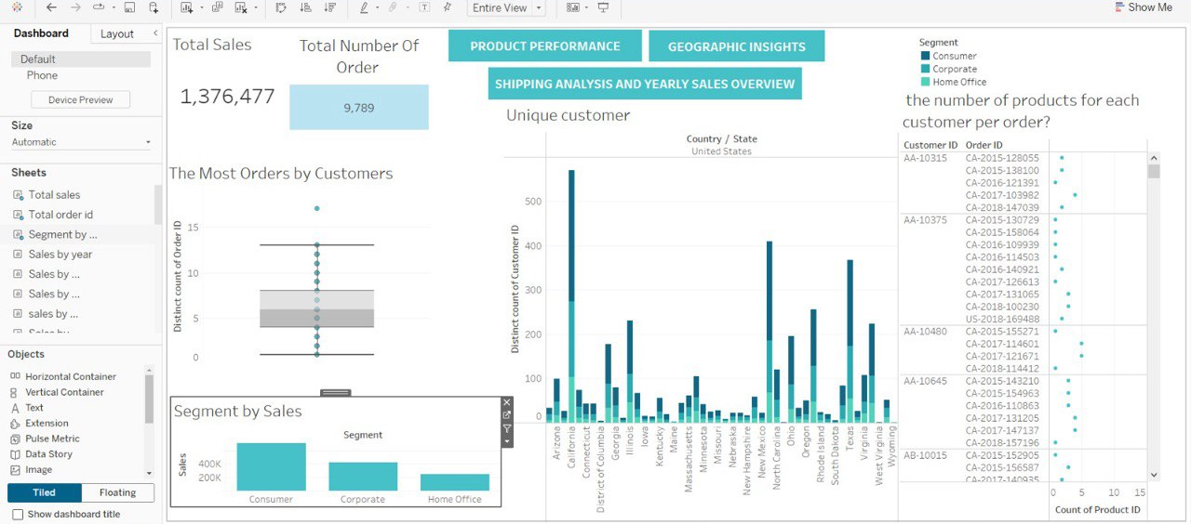
Customer performance

Slide 26
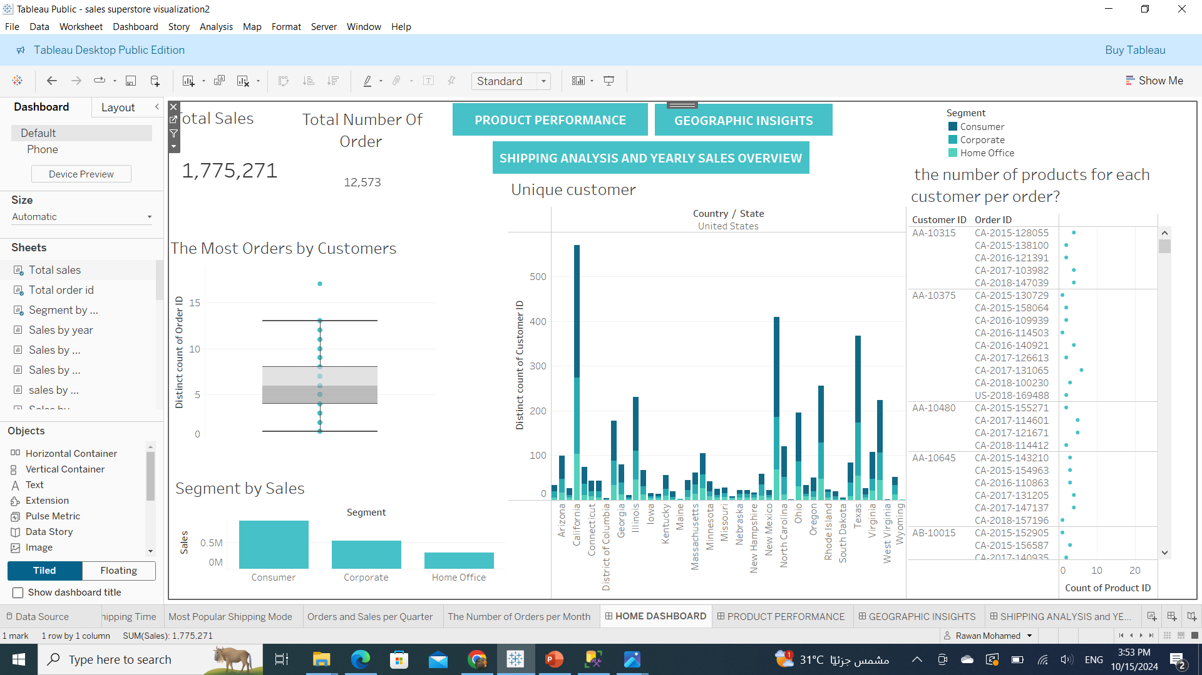
Customer performance
From the dashboard:
Sales ratio is lower in the home office category and higher in the consumer category
As for customers in most cities, California achieved the highest percentage of customers and the cities with the lowest North Dakota: Maine

Slide 27
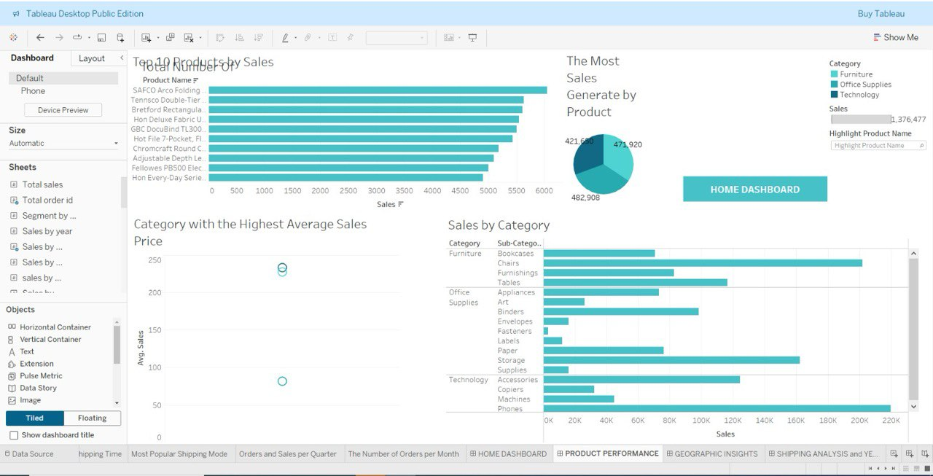
Product Performance

Slide 28
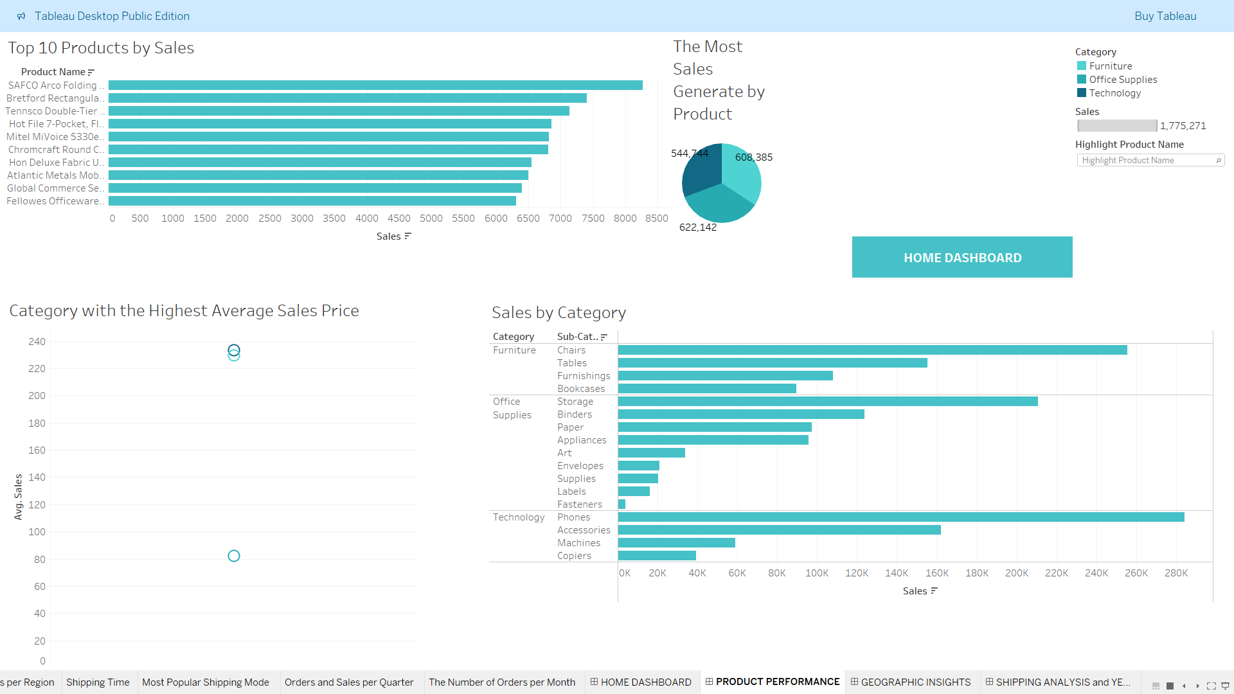
Product Performance
Through the Dashboard
Highest sales percentage achieved in the product category (Product SAFCO Arco Folding Chair )
Note the lowest sales percentage in Sub-Category (Fasteners-labels)

Slide 29
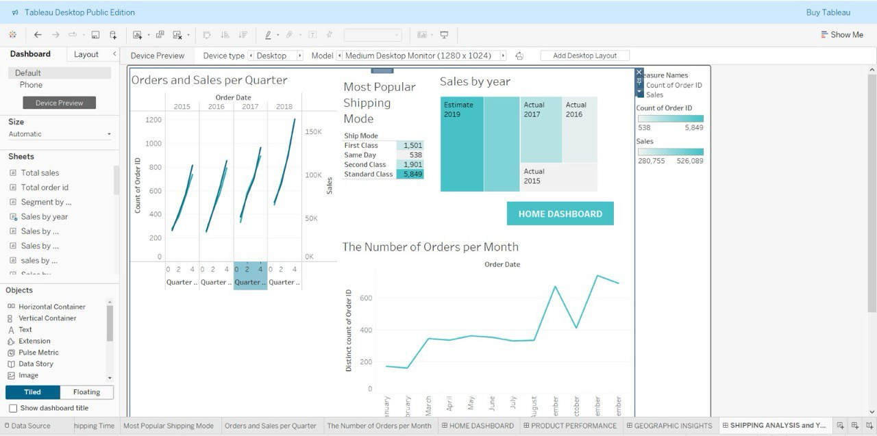
Shipping Performance

Slide 30
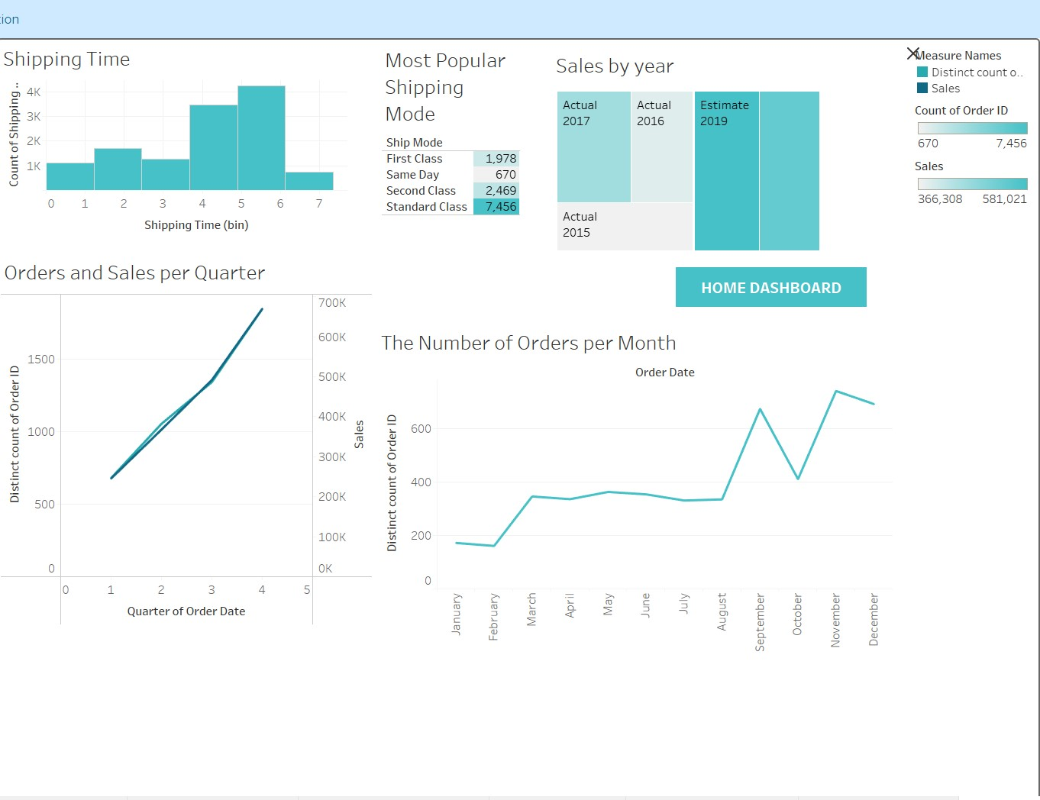
Shipping Performance
Through Dashboard
The most preferred method by customers (Standard Class)
As for the demand rate, it decreases in January and increases to its highest rate during November and August, and the demand rate decreases during October.
The average sales rate over the course of 4 years has been continuously increasing.

Slide 31
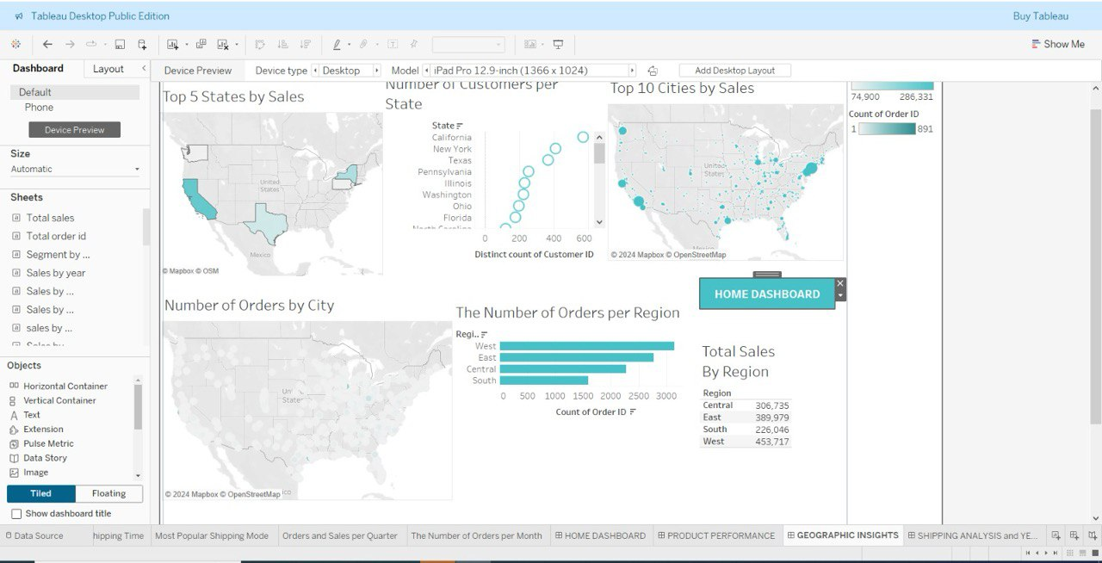
Geographic Performance

Slide 32
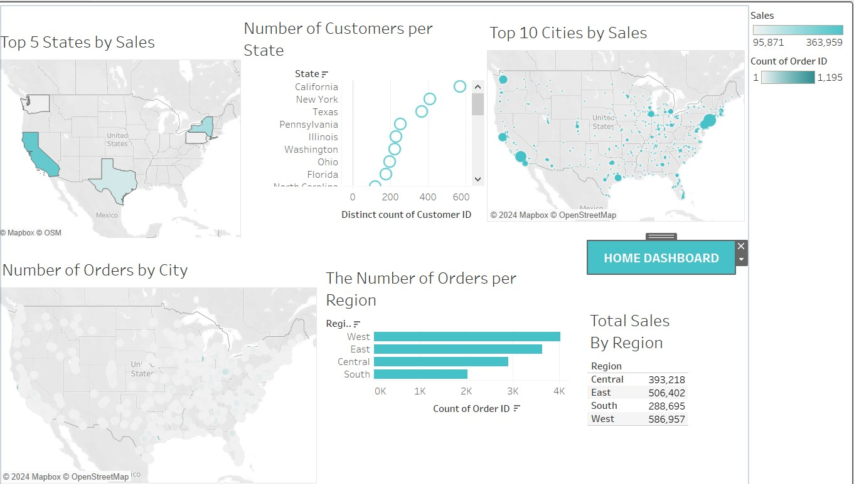
Geographic Performance
Through Dashboard
Highest sales and demand rate in West
Lower Sales and Demand rate in South
TOP 5 States:
California
Taxes
New York
Pennsylvania
Washington

Slide 33
Solution And Recommendation
1.Improve Underperforming Segments
Solution: Target marketing efforts toward Corporate and Home Office customers.
Recommendation: Institute volume discounts and subscription services to incentivize increased use.
2. Increased Market Penetration in Low-Engagement States
Solution: Running region-specific campaigns, while partnering up with the local influencer in the worst-performing states.
Recommendation: Focus sales efforts on states like Kentucky and South Dakota to diversify revenue streams.

Slide 34
Solution And Recommendation
3. Product Portfolio Optimization
Solution: Analyse product performance and stop or promote low performing products accordingly.
Recommendation: Apply product bundling where low- and high-demand products can be combined to improve average order size.
4. Improve Shipping Efficiency
Solution: This could be achieved by using alternative carriers or optimally placing warehouses in that region to reduce delivery times.
Recommendation: Real-time tracking, faster shipping options are highly recommended to enhance customer experience.

Slide 35
Any Questions ?

Slide 36

Questions answers with code

Slide 37
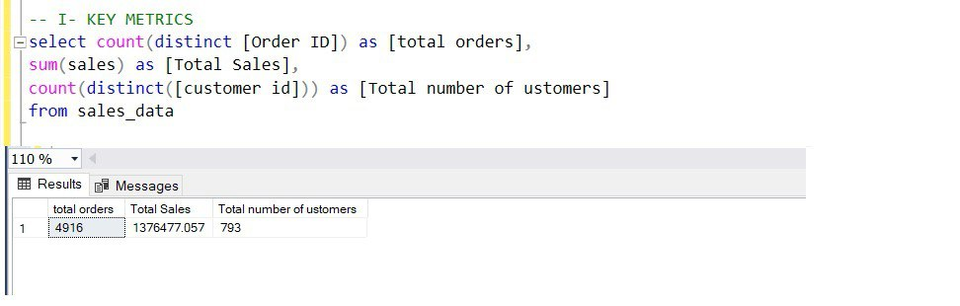
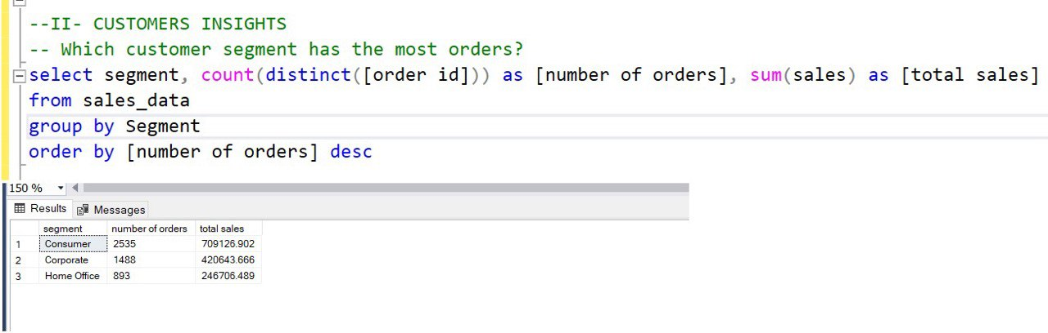

Slide 38
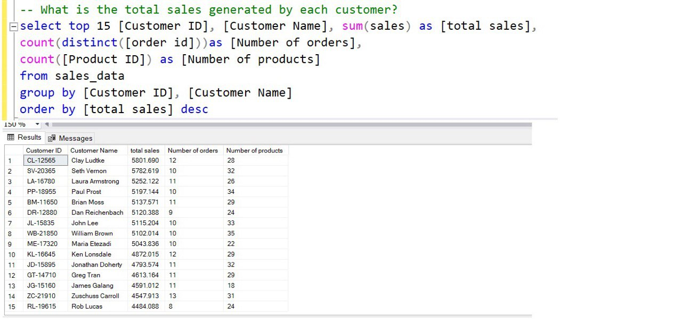

Slide 39
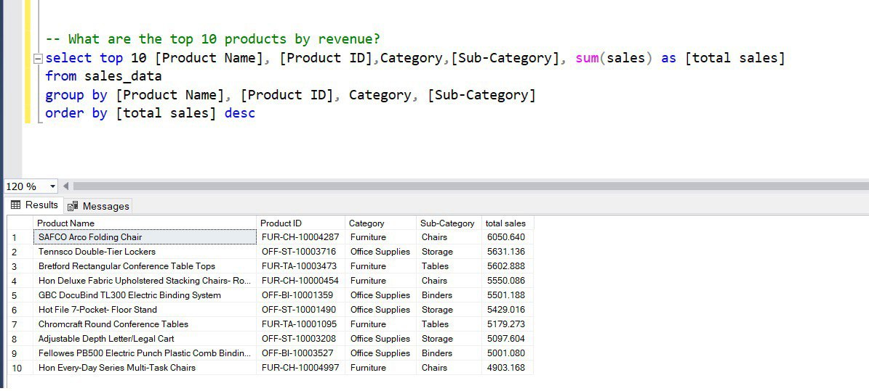

Slide 40
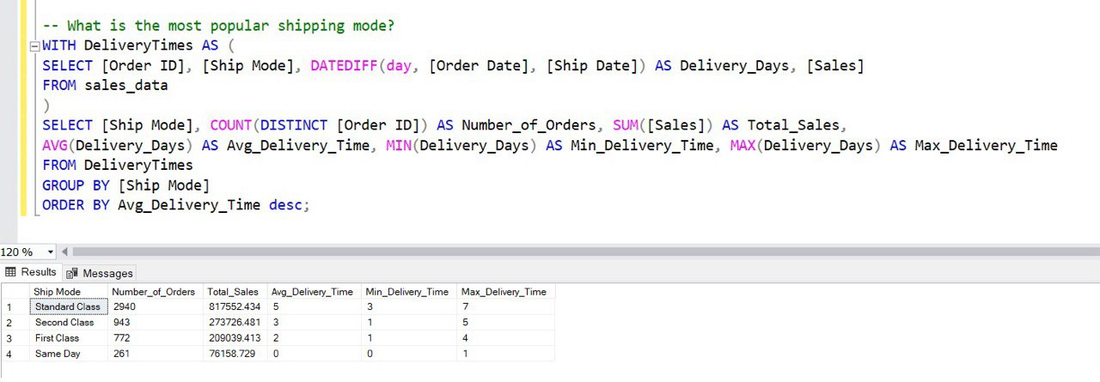

Slide 41
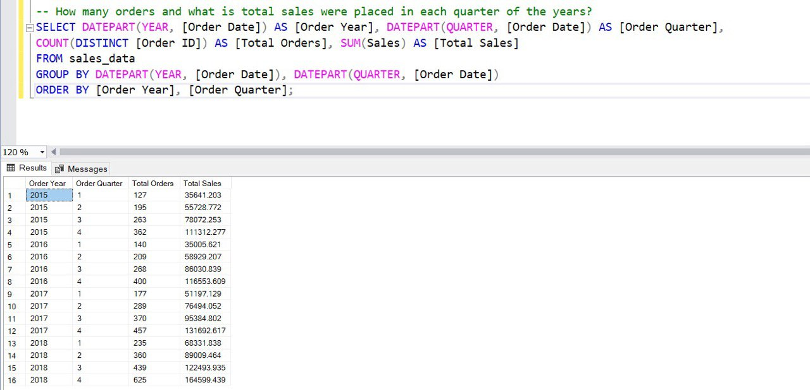

Slide 43
Forecasting Questions answers

Slide 44
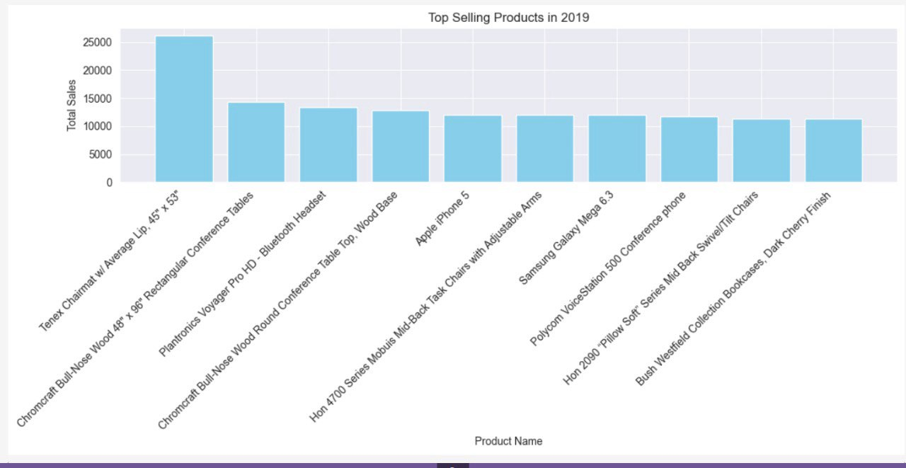
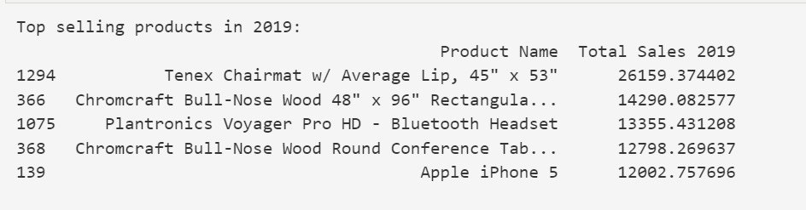
What are the top-selling products expected to be in the next month?

Slide 45
What are the top-selling products expected to be in the next month?

Slide 46
Preprocessing and Forecasting
outputs

Slide 47
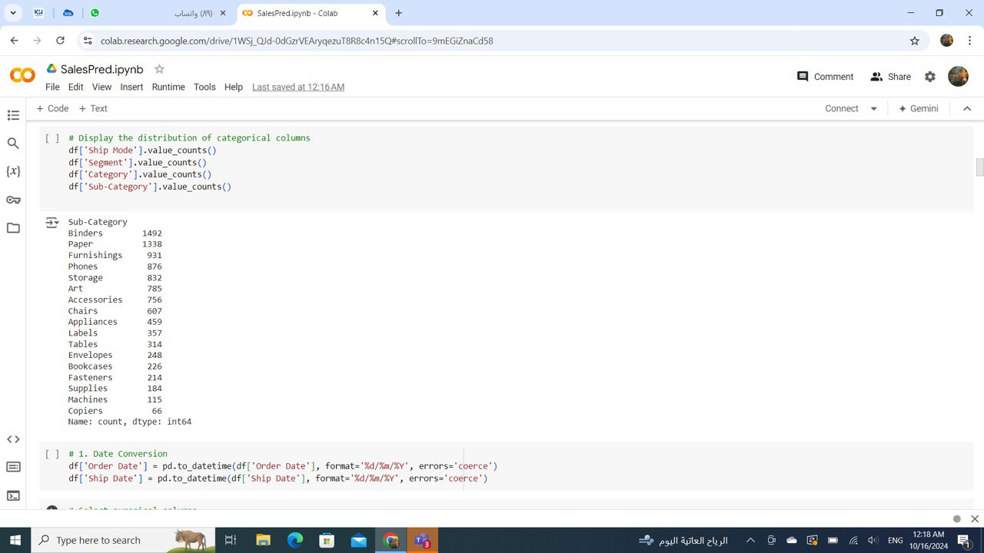
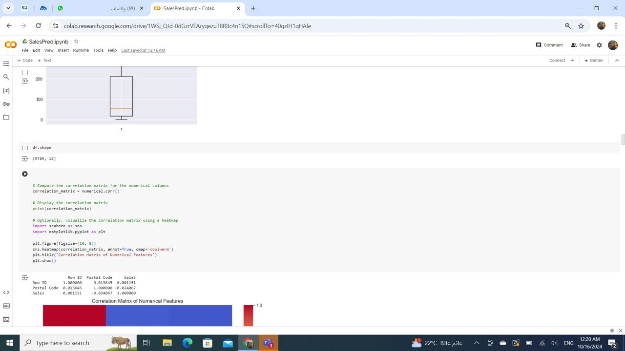
Preprocessing ouputs

Slide 48
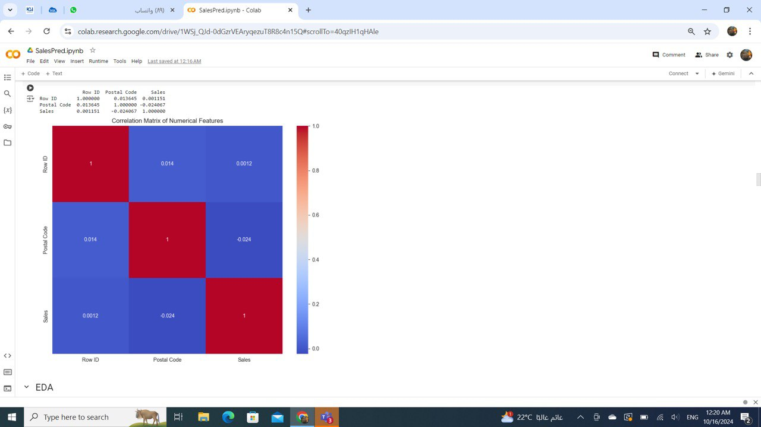
Preprocessing outputs

Slide 49
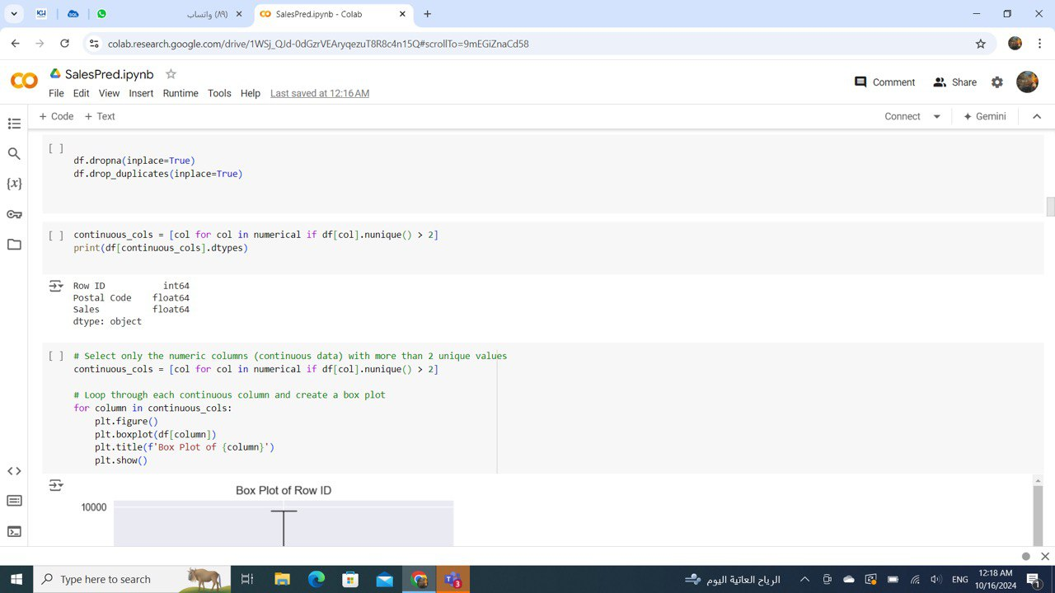
Preprocessing outputs

Slide 50
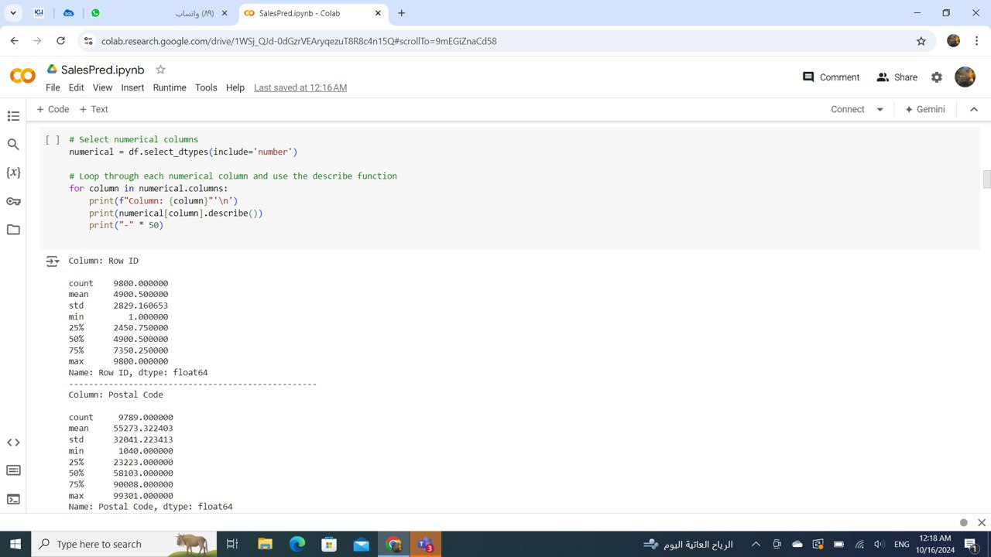
Preprocessing outputs

Slide 51
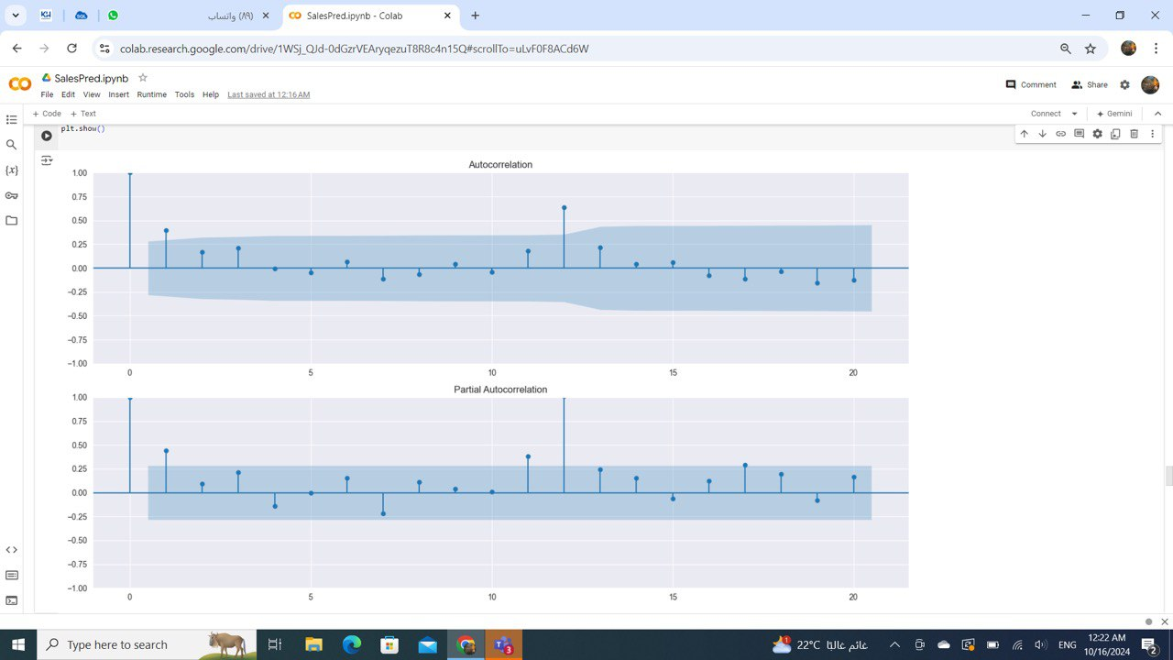
Preprocessing outputs

Slide 52
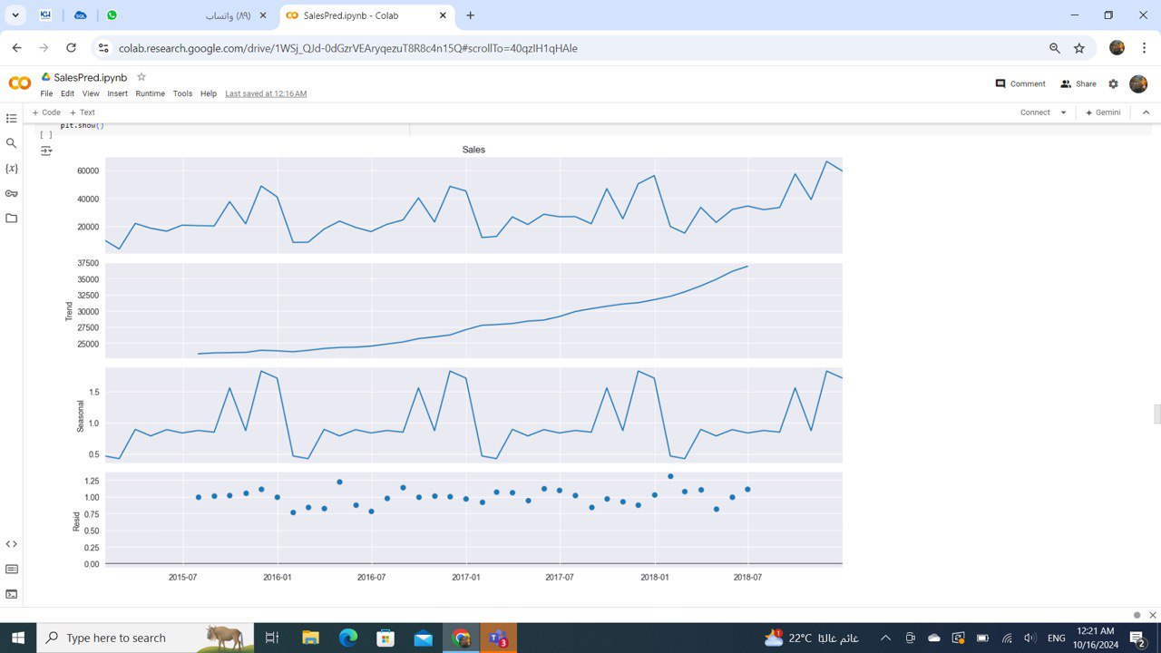
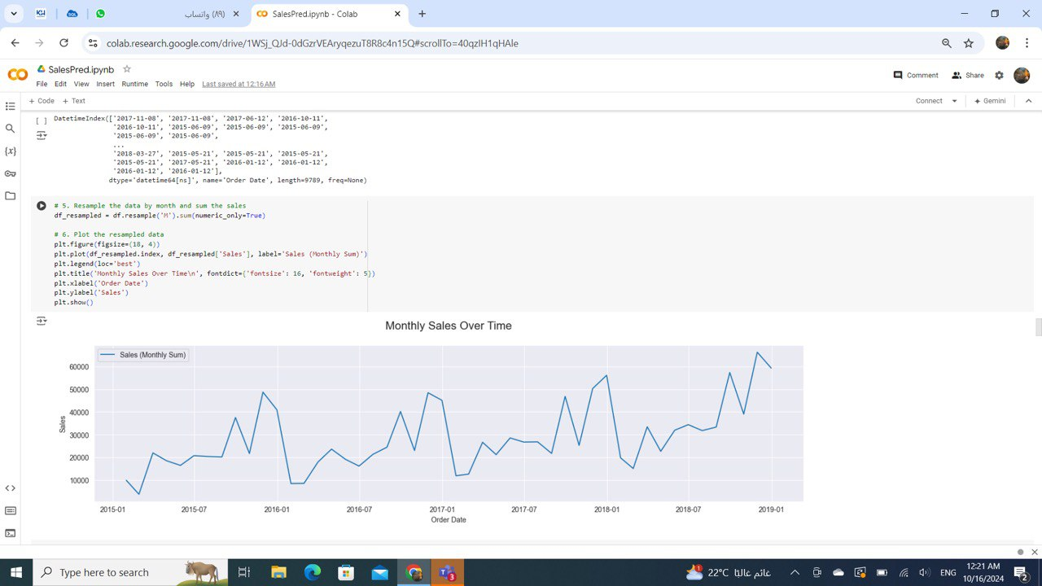
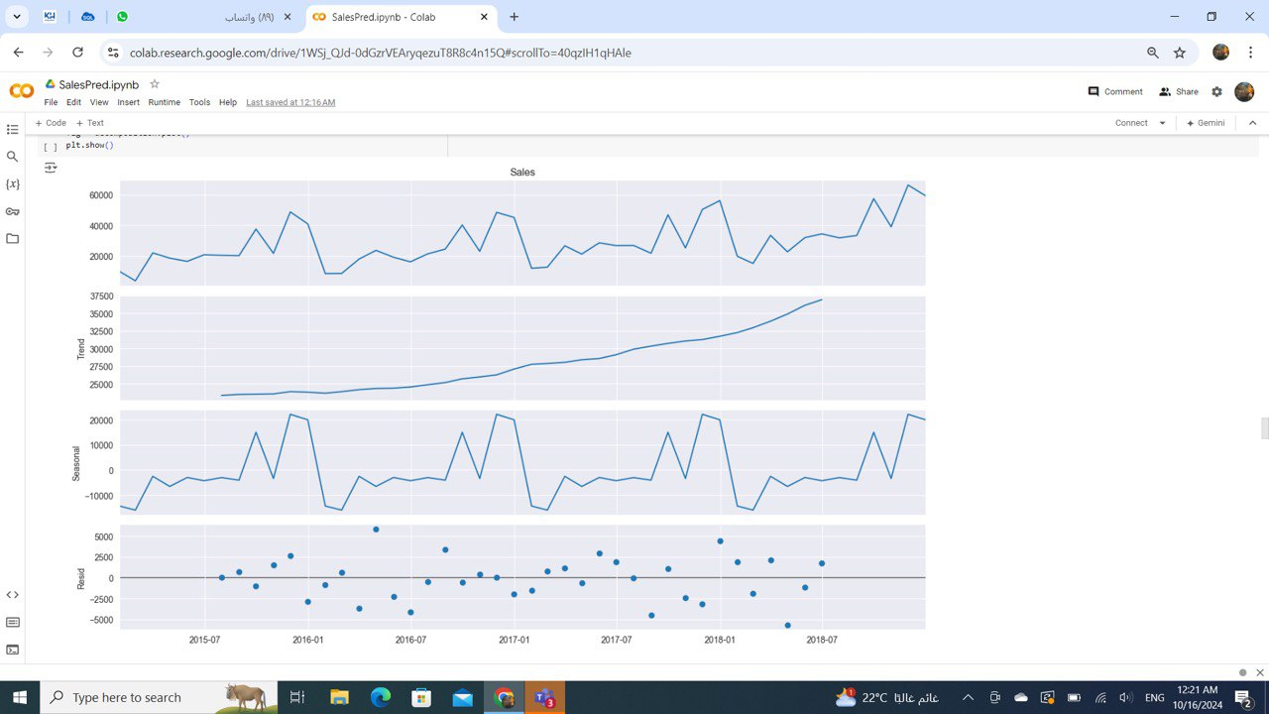
Forecasting outputs

Slide 53
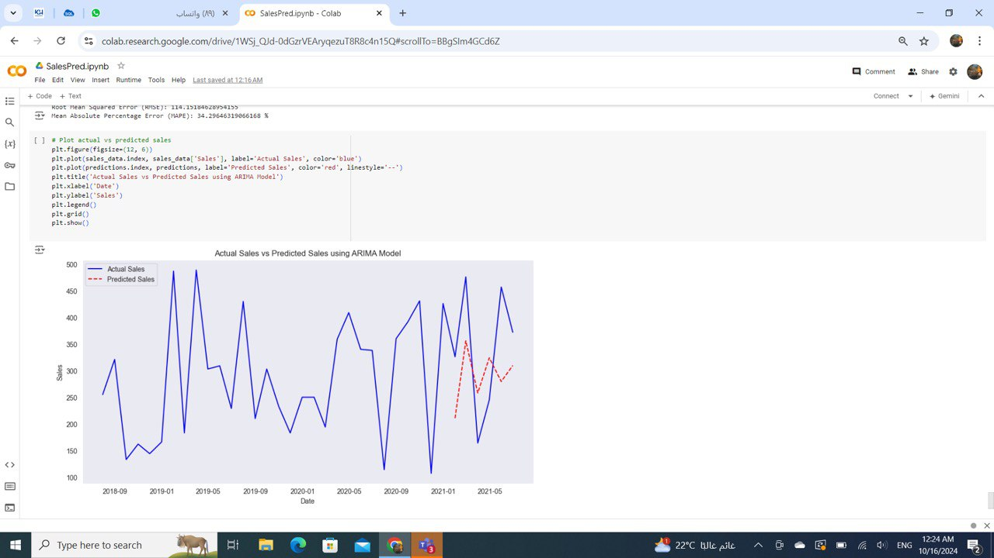
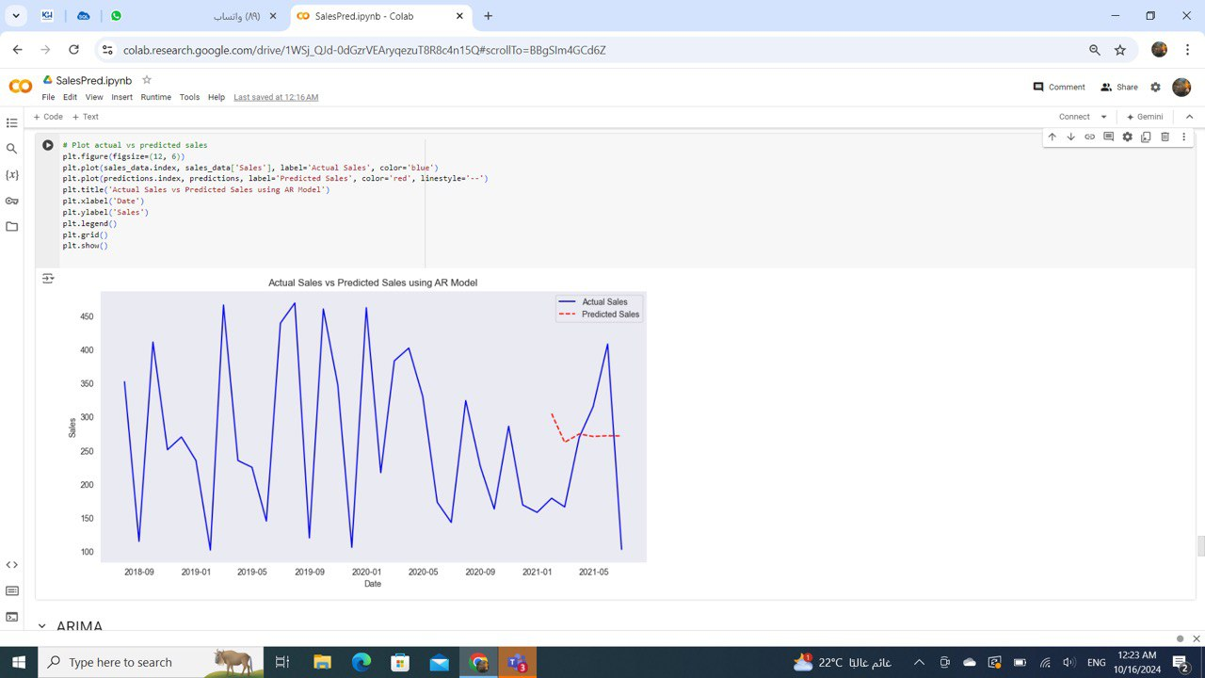
Forecasting outputs

Slide 54
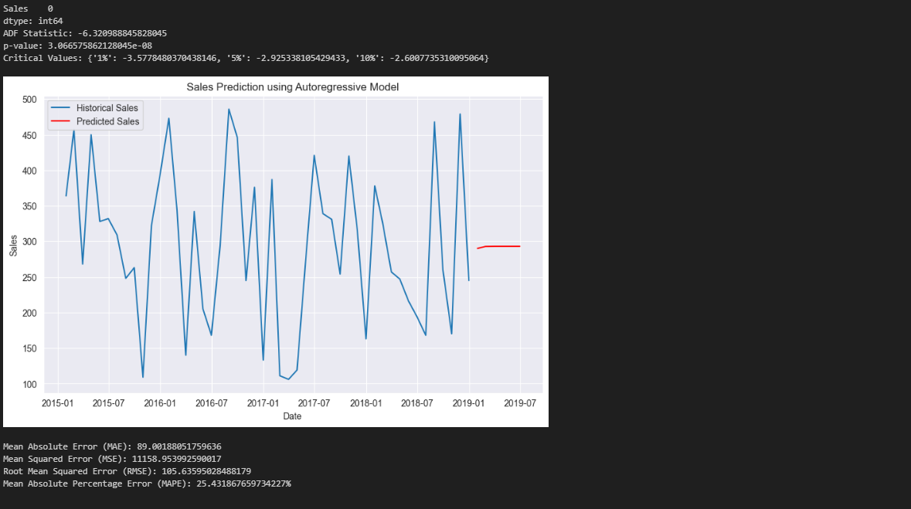
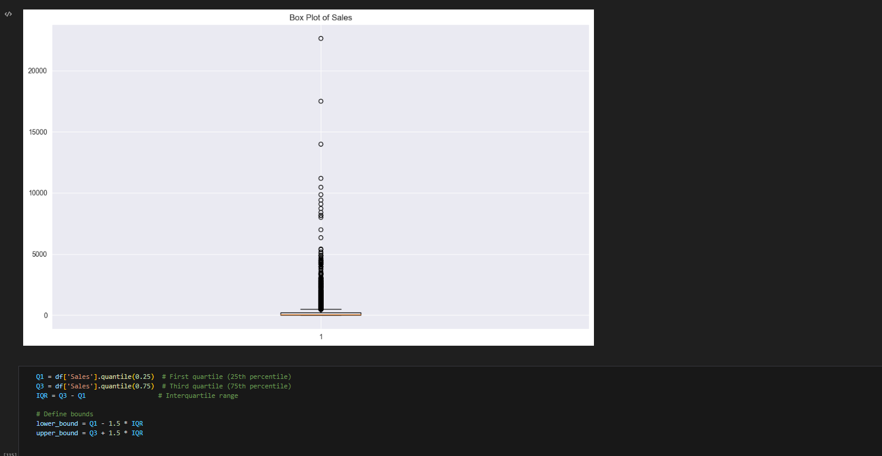
Forecasting outputs

Slide 55
Forecasting outputs

Slide 56
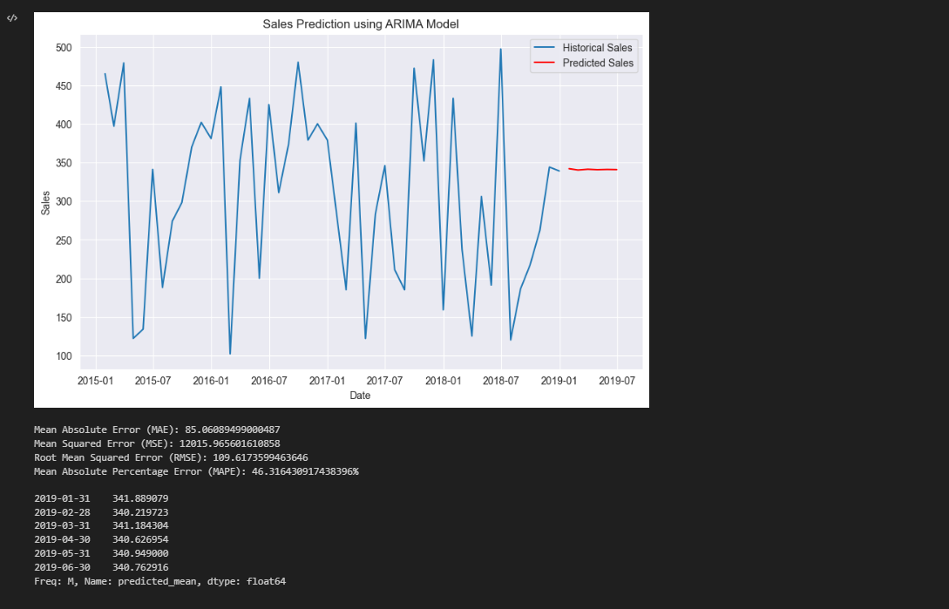
Forecasting outputs

Slide 57
Forecasting outputs

